Slide 1
High Frequency Trading and Mini Flash Crashes
Authors: Anton Golub, John Keane, and Ser-Huang Poon
Presented by: Xiumin Li

Slide 2
Authors
Anton Golub—Used to be a researcher in Manchester Business School of University of Manchester, currently the CEO of a Liquidity provider for digital assets company
John Keane — PhD Student at The University of Manchester
Ser-Huang Poon — Professor of Finance at Manchester Business School

Slide 3

Agenda
Paper Contents
  Introduction
  Background
  Dataset
  Descriptive Analyses and Results
  Liquidity shocks
  Fleeting Liquidity
  Conclusion
My thoughts

Slide 4
Introduction
High Frequency Trading(HFT)
“May 6th,2010 Flash Crash”
Regulation National Market System(Reg NMS)
Top of the Book Protection--NBBO
Intermarket sweep orders (ISO)
Notes:
(1)High frequency trading (HFT) gained prominence in the media after May 6th 2010, the day when the U.S stock market experienced one of its most severe price drops in history.
(2)May 6 started as an unusually turbulent day for the U.S stock markets, the Dow Jones Industrial Average (DJIA) index dropped by almost 9% from the open The crash was so rapid that the index tumbled 900 points in less than 5 minutes, but recovered the bulk of its losses in the next 15 minutes of trading
(3)Regulation National Market System (NMS) is a set of rules passed by the Securities and Exchange Commission (SEC), which looks to improve the U.S. exchanges through improved fairness in price execution as well as improve the displaying of quotes and amount and access to market data.
(4)An order book is an electronic list of buy and sell orders for a specific security or financial instrument organized by price level.
The top of the book is where you‘ll find the highest bid and lowest ask prices， which is the NBBO(The National Best Bid and Offer)
The top of the book protection is one of the Order Protection Rule aims to ensure that investors receive the best price when their order is executed ,this rule is aimed at removing trading through activities(to avoid that the orders are executed at a worse price)
(5)Intermarket sweep orders (ISO) is a type of stock market order that sweep several different market centers and scoop up as many shares as possible from them all.
An ISO is a limit order designated for quick and automatic execution in a and can be executed at the target market even when another market center is publishing a better quotation. Without the need to search for the best quote during their execution, such orders can possibly achieve faster execution than regular market orders.
When submitting an ISO, the submitting investor also needs to fulﬁll Regulation NMS order protection rules by concurrently sending orders to other market centres with Protected Quotations.
Importantly, ISO orders are not subject to auto-routing
The sweep ends when the order quantity is satisﬁed, the limit price is reached,

Slide 5
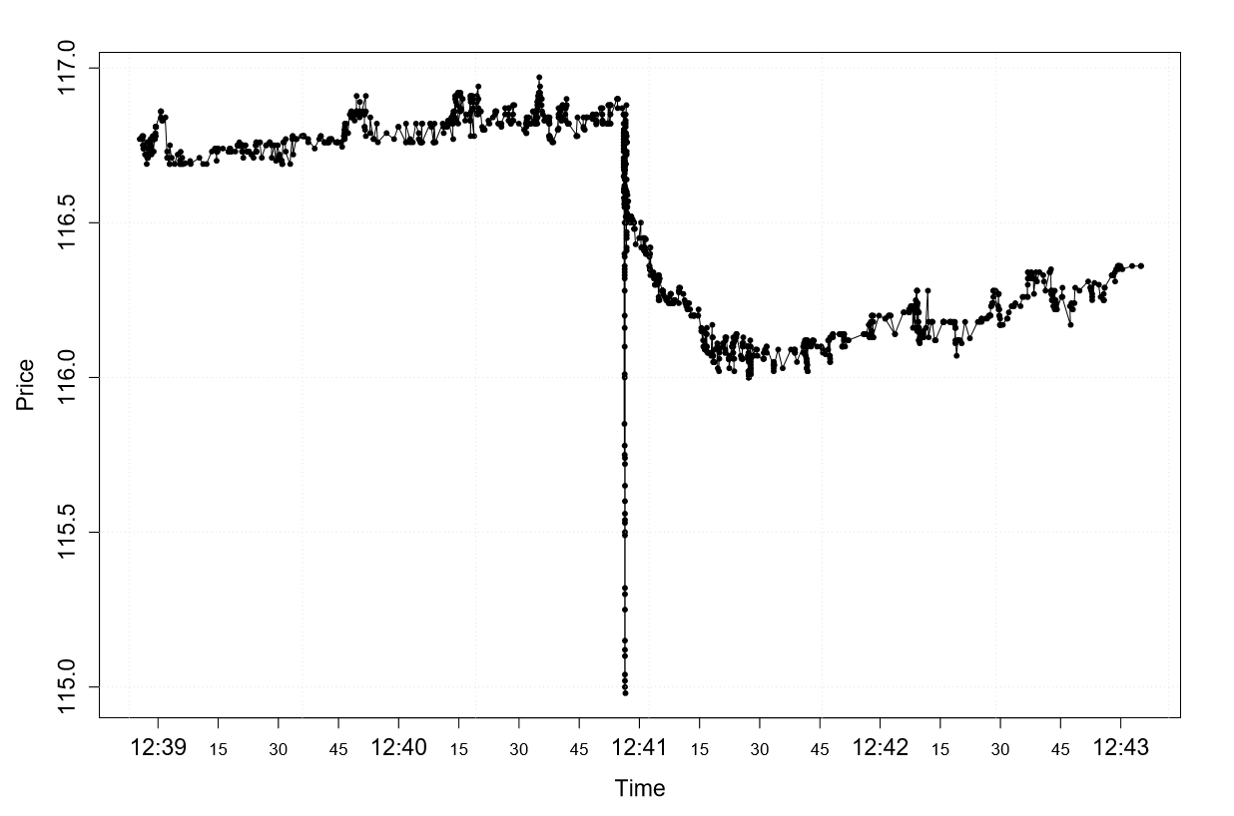
Introduction
An example of Mini Flash Crash
The ﬁgure shows a Mini Flash Crash occurring at NYSE in the stock of Goldman Sachs Group, Inc. (NYSE ticks: GS) on October 7th 2008, resulting in a 1.6% price drop in less than 400 milliseconds. The crash consisted of 58 trades, where the last 57 were marked ISO, for a total volume of 86000 shares, reducing the price $1.89 from its initial values.
Notes:
Mini Flash Crashes are abrupt and severe price changes that occur in an extremely short period.
They are scaled down versions of the May 6th 2010 Flash Crash.

Slide 6
Background—The cause of May 6th 2010 Flash Crash
The joint report of the SEC and the Commodity Futures Trading Commission (2010)
HFTs did not trigger the Flash Crash, though their responses caused a “hot potato” eﬀect on the unusually large selling pressure on that day exacerbated market volatility.
Kirilenko et. al. (2011)
Nanex(2010)
The report attributed a sell order in the eMini S&P 500 futures market as the cause of the Flash Crash.
The quote stuﬃng and delays of data feeds in NYSE Consolidated Quotation System (CQS) created a positive feedback loop set-oﬀ the crash.
Notes:
This section provides a survey of previous literature and defines Mini Flash Crashes
Previous research has mainly focused on the cause of the May 6th 2010 Flash Crash.
(1)The joint report of the SEC and the Commodity Futures Trading Commission (2010) attributed a sell order in the eMini S&P 500 futures market as the cause of the Flash Crash.
The report stated that HFTs did not start the crash but they generated a “hot-potato” volume accelerating mutual fund’s sell side pressure and contributing to the sharp price declines that day.
[Much of the volume on May 6 was just positions being moved back and forth over a matter of seconds between high-frequency traders and other market makers.---”Hot potato volume”]
(2)In contrast, Nanex (Nanex, 2010) concluded that quote stuﬃng and delays of data feeds in NYSE Consolidated Quotation System (CQS) created a positive feedback loop that set-oﬀ the crash.
(3) Kirilenko et. al. (2011) HFTs did not trigger the Flash Crash, though their responses caused a “hot potato” eﬀect on the unusually large selling pressure on that day exacerbated market volatility.
(4)Also there are some other papers talked about the reasons for this flash crash, such as the overuse of ISO(intermarket sweep orders) the contagion and fragility in the market.

Slide 7
Background—Characteristics of Mini Flash Crashes
down crash
It has to tick down at least 10 times before ticking up;
price changes have to occur within 1.5 seconds;
up crash
It has to tick up at least 10 times before ticking down;
price changes have to occur within 1.5 seconds;
price change has to exceed -0.8%.
price change has to exceed 0.8%.
Notes:
(1)To qualify as a down crash candidate, the stock price change has to satisfy the following conditions:…
(2)Likewise, to qualify as an up crash candidate, the stock price change has to satisfy the following conditions:…

Slide 8
Dataset
The dataset used in this study includes all quotes disseminated by the Consolidated Quotation System (CQS) and trades disseminated by Consolidated Tape System (CTS) for NYSE, NYSE Amex, NYSE Arca listed securities, and Unlisted Trading Privileges (UTP) Quote Data Feed disseminated quotes and UTP Trade Data Feed disseminated trades for NASDAQ listed securities.
The messages are placed in the database as they are aggregated from the Security Information Processor (SIP), and correspond to the information that professional traders receive in real-time. Each message is time stamped to a precision of 25 milliseconds, and contains information relating to time, price, size, exchange issuance and eventual trade or quote condition.
Notes:
NYSE, NASDAQ, ARCA, AMEX, BATS, ISE

Slide 9
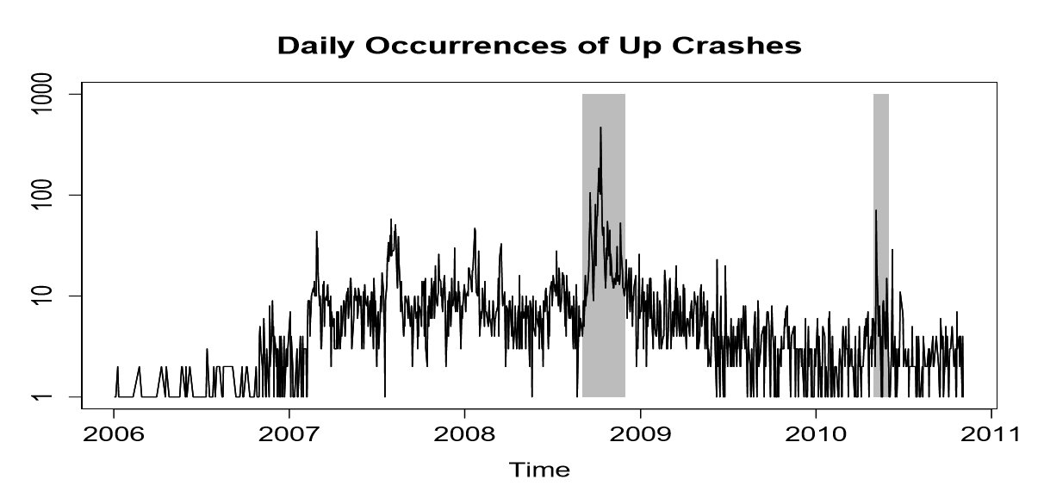
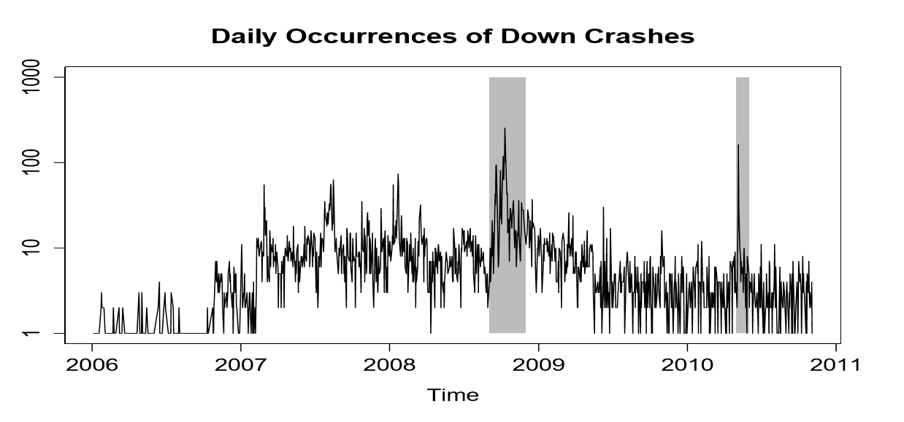
In this study we have analyzed four months of Mini Flash Crashes occurring in September to November 2008, and May 2010.
The dataset covers over one-quarter (27.75%) of all Mini Flash Crashes reported to have occurred in the period of 2006-2011.
(i) The corresponding periods were highly volatile including the unfolding of the global ﬁnancial crisis, and the collapse of Lehman Brothers and the May 6th 2010 Flash Crash;
(ii) Analysis of Mini Flash Crashes means processing billions of trades and quotes, therefore we selected months with the most crashes.
Notes:
The above two Figures present the daily number of up and down crashes from the period 2006-2011. The shadowed area indicates the crashes analysed in this study.
The Y axis presents the number of daily occurrences and is on a log scale.
(so as to creating graphs to compress the scale and make the data easier to comprehend)

Slide 10
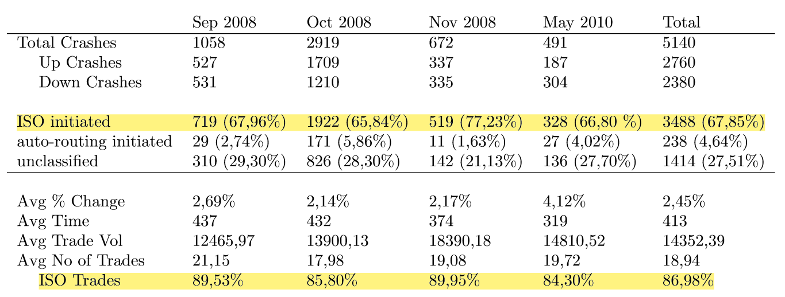
Descriptive Analyses and Results
(i) Avg % Change is the average total percentage price change in a crash.
(ii) Avg Time is the average time of the crash in milliseconds;
(iii) Avg Trade Vol is the average total volume of the trades;
(iv) Avg No of Trades is the average number of trades;
(v) ISO Trades is the average number of ISO marked trades, as a percentage of total number of trades.

Slide 11
Descriptive Analyses and Results
ISO-initiated Mini Flash Crashes
The trades constituting the Mini Flash Crash have to be marked ISO, except for the ﬁrst k trades that can be marked as non-ISO if they are executed within the least aggressive market-wide available best quotes in the previous one second.
The k mentioned trades can be part of the Order Protection compliance of ISO trades initiated at another exchange, followed by regular marked trades at the domestic exchange, and therefore not a part of the ISO package of trades constituting a Mini Flash Crash that sweeps the order book.
The ﬁrst k trades may be a part of an auto-routing procedure of another exchange complying with the Order Protection Rule, and therefore not relevant to the mechanics of ISO-initiated Mini Flash Crashes, as the auto-routing procedure will only send the part of the order matching the displayed depth at the Top of the Book, while the remaining balance of the order will be ﬁlled elsewhere.
Notes:
In order for a crash to be classiﬁed as ISO-initiated, it has to satisfy the following:
The conditions deﬁning a Mini Flash Crash set out in Section 2 must be satisfied.
….
The motivation for allowing the ﬁrst k trades to be marked as non-ISO is twofold. ….
Further explain:
To further explain what’s iso initiated crashes, we can see this left figure.
ISO Initiated Mini Flash Crash：A trader submits a package of ISO-marked orders to exchange A and simultaneously sends ISO-marked orders matching the size of Protected Quotes to all trading venues quoting at the NBBO. ISO-marked orders rip through the order book at exchange A resulting in a Mini Flash Crash, despite the additional liquidity available deeper in the order book at other trading venues.

Slide 12
Descriptive Analyses and Results
Auto-routing initiated Mini Flash Crash
Trades constituting the Mini Flash Crash have to be marked as regular, except for the ﬁrst k trades that can be marked as non-regular if they are executed with the least aggressive market-wide available best quotes in the previous one second.
Prior to execution of regular marked trades constituting the Mini Flash Crash, the Top of the Book has to be cleared for all exchanges quoting at the NBBO.
Notes:
The justiﬁcation for allowing the ﬁrst k trades to be marked as non-regular is similar to that in the ISO-initiated Mini Flash Crash deﬁnition. The last condition requires that quotes matching the NBBO are cleared as a part of the routing procedure of trades constituting the auto-routing-initiated Mini Flash Crash.
when an exchange receives an order and it is not displaying the NBBO, in order to comply with the Order Protection rule, it has to route part of the order to exchanges showing the NBBO.
Further explain:
Auto-routing initiated Mini Flash Crash: A trader submits an order to exchange A and, as exchange A is not displaying the NBBO, the part of the order matching the size of the Protected Quotation at exchange B will be routed to comply with the Order Protection rule. Once the Protected Quotation at exchange B is cleared, the resulting balance of orders will be ﬁlled at exchange A regardless of the prevailing liquidity at other trading venues, resulting in a Mini Flash Crash.

Slide 13
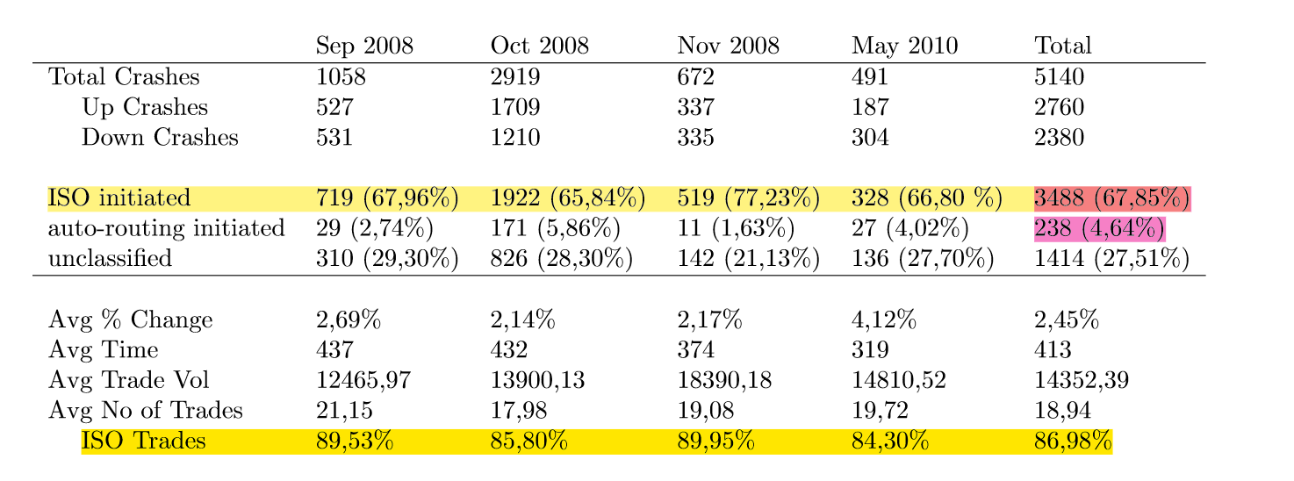
Descriptive Analyses and Results
While the two types of Mini Flash Crashes are diﬀerent in their underlying mechanics, both types are the result of the lack of protection for Depth of Book quotations.
Who might be causing Mini Flash Crashes？
As stressed earlier, most crashes happen due to aggressive use of ISOs. ---HFT activity
Notes:
Following these deﬁnitions the paper classify 3488 (67.85%) of crashes as ISO-initiated and 238 (4.64%) as auto-routing-initiate;
So that an extremely high number of ISO marked trades can be immediately noticed, where they constitute the overwhelming majority of trades in the crashes.
-----While---
In many cases there is a signiﬁcant amount of liquidity on the other exchanges during the time frame of interest, available deeper in the order book. However, as the Order Protection rule only protects the Top of the Book, trades can occur at vastly inferior prices resulting in Mini Flash Crashes in a particular exchange.
Finally, we speculate on who might be causing Mini Flash Crashes. ……
ISO-initiated trades can only be executed by broker-dealers and traders with sponsored access. As typical institutional or retail investors do not have access to such trading mechanisms, they can clearly be ruled out as potential perpetrators. Given the speed and the magnitude of the crashes, it appears likely that Mini Flash Crashes are caused by HFT activity.

Slide 14
Liquidity Shocks
Previous Studies
Computerized trading improves traditional measures of market quality and contributes to price discovery.
Previous studies are bounded by strong assumptions and only provide a summary parameters typical of econometric analysis.
Mini Flash Crashes overlooked
Examine market quality by placing Mini Flash Crashes at the centre of our analysis with an event study and evaluate the diﬀerence in market liquidity 60 seconds before and after the occurrence of Mini Flash Crashes.
This
Paper
Notes:
Despite the criticisms of computerized trading by the popular press and market participants, academic work has found little evidence that the practice is detrimental to ﬁnancial markets. Recent studies show that, in general, computerized trading improves traditional measures of market quality and contributes to price discovery.
Previous studies are bounded by strong assumptions and only provide a summary parameters typical of econometric analysis. Also, they have focused on the great mass of the data where individual events such as Mini Flash Crashes, though extreme and unusual, can be easily overlooked.
In this section we examine market quality by placing Mini Flash Crashes at the centre of analysis with an event study and evaluate the diﬀerence in market liquidity 60 seconds before and after the occurrence of Mini Flash Crashes to find the relationship between the HFT activities and Liquidity Shocks.

Slide 15
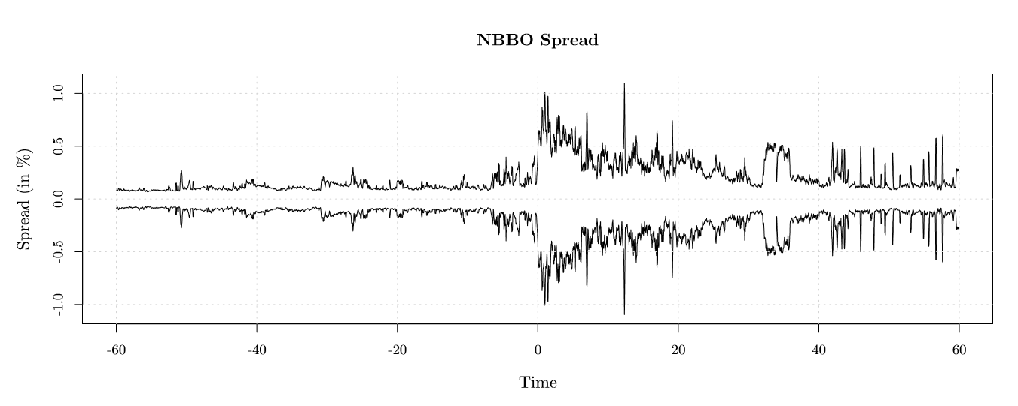
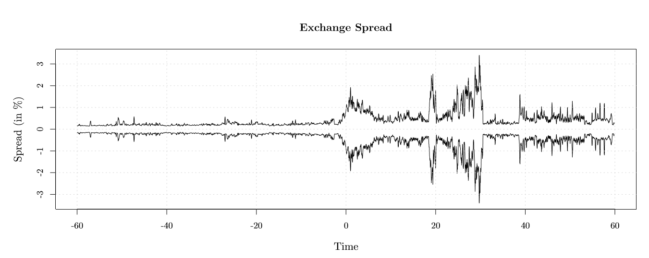

Liquidity Shocks—Spread Differences
$$MidPrice=\frac{offer+bid}{2}$$
$$Spread=\frac{offer−bid}{MidPrice}∙100\%$$
Notes:
Deﬁne midprice as the average of the quoted bid and oﬀer…. And compute the spread as:
(The quoted spread is divided by midprice in order to account for pricing diﬀerential between low priced and high priced stocks.)
We evaluate the spread resulting from the quotes of the exchange where the Mini Flash Crash will occur, termed Exchange Spread
and also observing the NBBO derived midprice spread, termed NBBO Spread.
The figures show that Mini Flash Crashes have detrimental impact on the Exchange Spread and NBBO Spread. In the 60 seconds prior to the occurrence of a Mini Flash Crash both NBBO Spread and Exchange Spread are stable (and equal on average to 0.24% and 0.46% respectively. ) Both NBBO Spread and Exchange Spread rapidly increase after the Mini Flash Crash( to 0.58% and 1.32% ) in the following 60 seconds( which amounts to increases of 141.60% and 188.05% respectively. ) Furthermore, we notice that even though Mini Flash Crashes occur extremely fast (within 1.5 seconds by deﬁnition), their impact on quoted spread persisted for the whole 60 seconds afterwards.

Slide 16
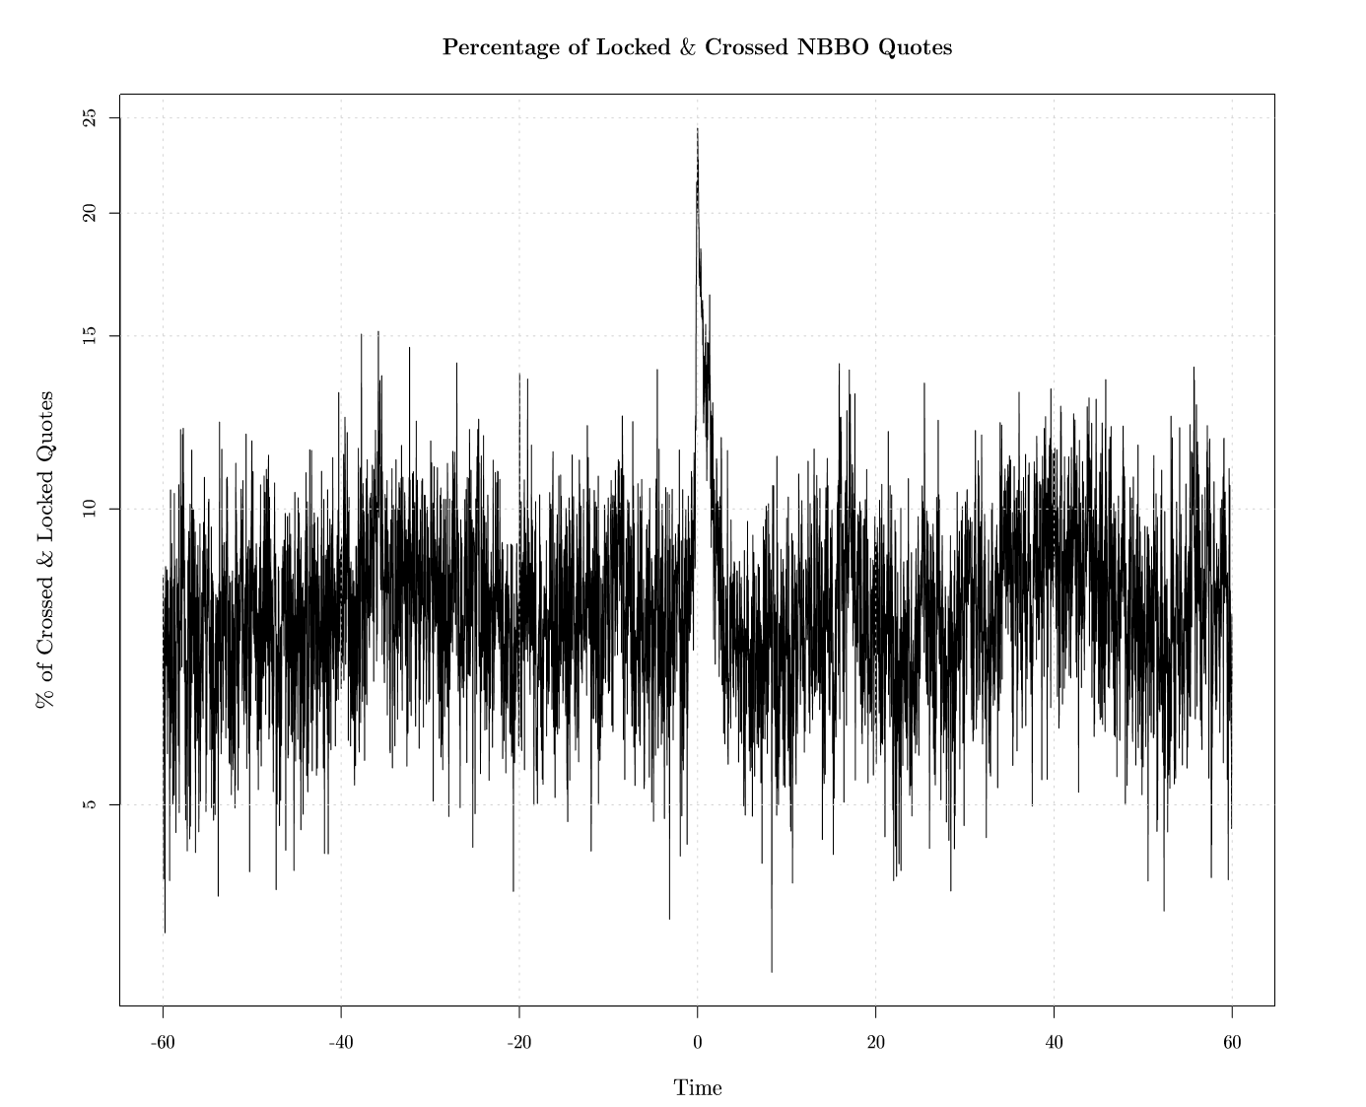

Liquidity Shocks—Locked and Crossed NBBO Quotes
Locked and crossed NBBO quotes occur when National Best Bid $≥$National Best Oﬀer
Rule 611 of Regulation NMS prohibits submission of a quote that would lock or cross the market.
Mini Flash Crashes have major impact on the percentage of locked or crossed NBBO quotes, which averaged 8.01% in 60 seconds before the crash, jumps to 24.40% after to crash and declines to 8.23% in the 60 after the crash.
Notes:
Next, we evaluate the percentage of locked and crossed NBBO quotes among all quotes before and after the Mini Flash Crashes.
Locked and crossed NBBO quotes occur in a given security when the National Best Bid is higher than, or equal to, the National Best Oﬀer
This kind of quotes are prohibited by Reg NMS, Because these quotes present risk-less proﬁt for the fastest traders as they can proﬁt by simultaneously buying the security at the crossed oﬀer quote and selling it at the crossed bid quote.
The left Figure shows Mini Flash Crashes have major impact on the increase of the percentage of these crossed quotes

Slide 17
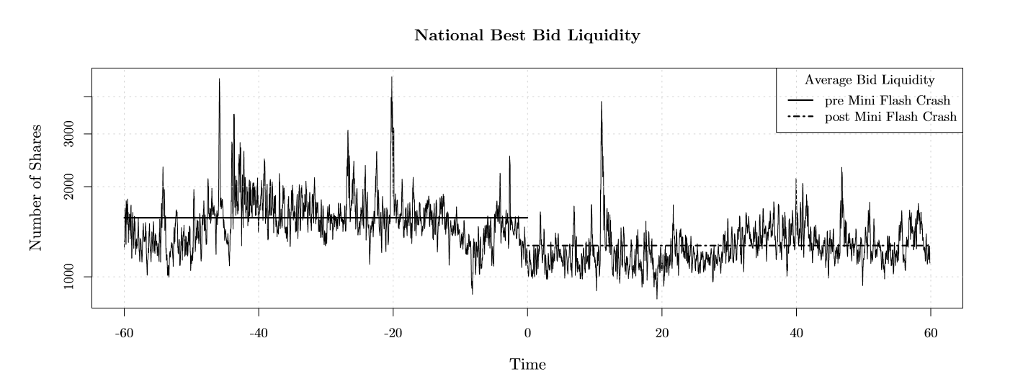
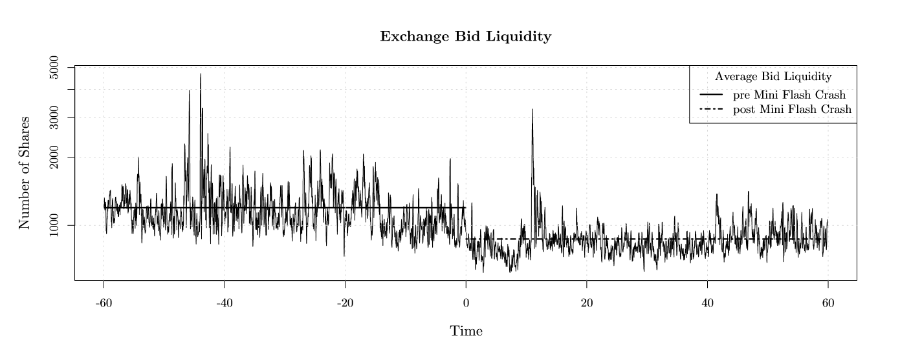
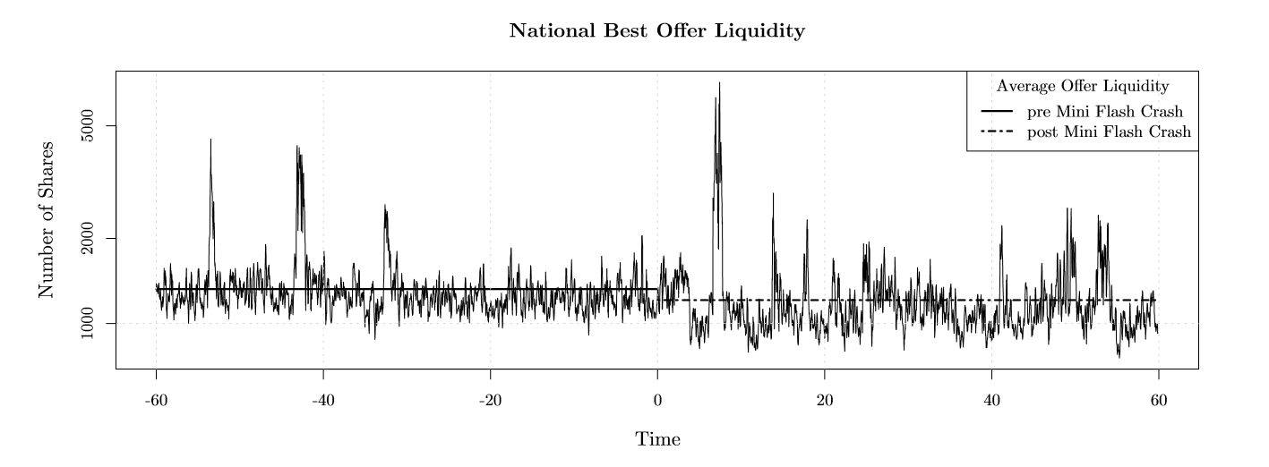
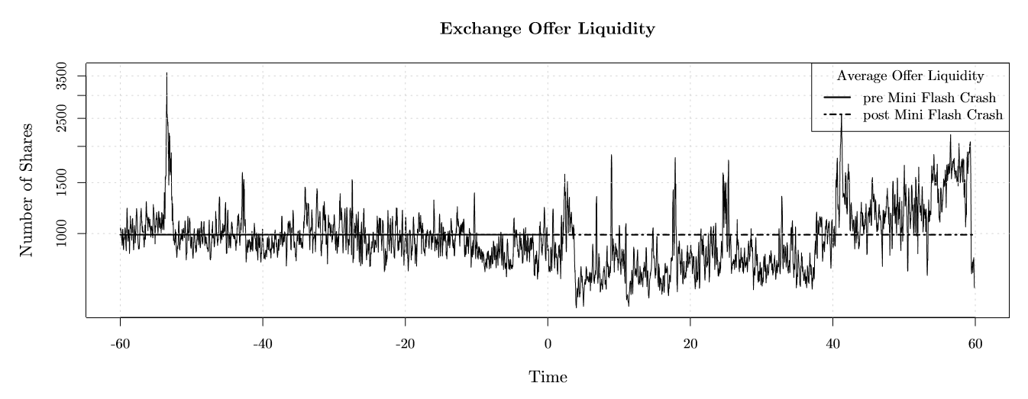
Liquidity Shocks—Quoted Volume
Notes:
Finally we analyse the average quoted volume, as measured by the number of shares, at the NBBO before and after the Mini Flash Crashes.
The left figures show the average quoted liquidity at the National Best Bid (upper graph) and National Best Oﬀer (lower graph) in the 60 second period before and after the occurrence of Mini Flash Crash. The Y-axis is in log scale. We can see that quoted volume at the NBBO decreases after the Crashes.
The right figures show the decrease in the quoted volume for the exchanges where the Mini Flash Crash occurred.
From the analysis of quoted liquidity we note that even though there is reduction in quoted liquidity both on the oﬀer and bid side after the occurrence
of Mini Flash Crashes, this reduction is asymmetric as the decrease is greater on the bid, and in fact there appeared to be sell-side pressure in the markets after the crash.

Slide 18
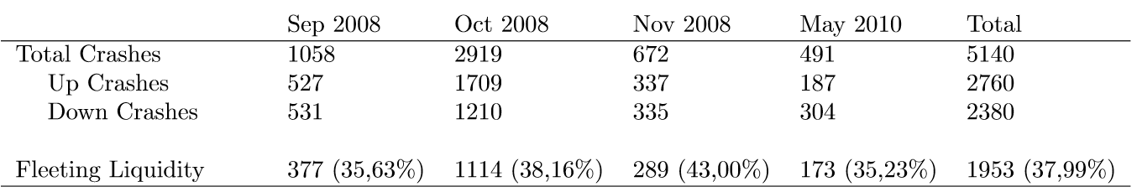
Fleeting Liquidity
People are relying on the [stock quote] data and the data is not real.” --Sean Hendelman, CEO at T3 Capital
Mini Flash Crashes present a unique opportunity to analyze displayed liquidity at a time of severe stress.
We note that the phenomenon of Fleeting Liquidity is as often as 37.99% of Mini Flash Crashes in our sample.
Notes:
Today’s traders operate in a tiered market environment where co-location and direct data feeds have made it possible for some participants to obtain tremendous speed advantage. They rapidly submit orders and instantaneously canceledthem. ---Which creates a false sense of overpriced supply and
Demand for a stock. Hence leading to the artificial liquidity.
However, Mini Flash Crashes present a unique opportunity to analyze displayed liquidity at a time of severe stress, as it is presumed that due to the speed of the crashes it is not possible to predict them and withdraw liquidity by cancelling resting limit orders.
The figure below shows the Statistics of Mini Flash Crashes with Fleeting Liquidity phenomenon

Slide 19
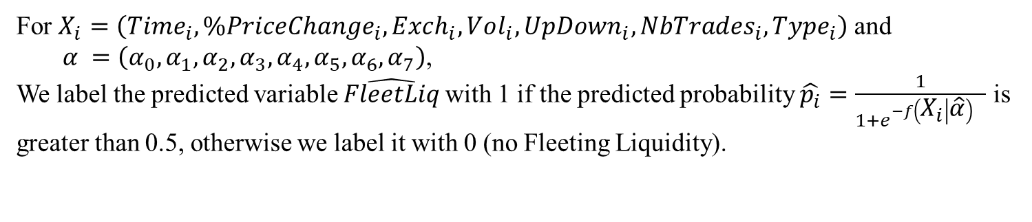
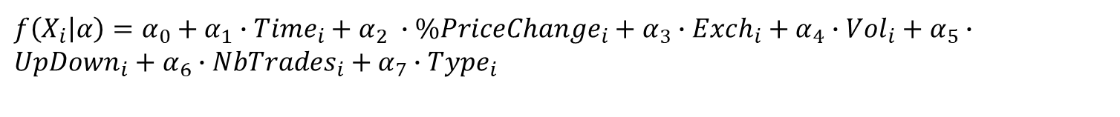

Fleeting Liquidity
$$ln\left(\frac{P\left(FleetLiq_{i}=1\right)}{1−P\left(FleetLiq_{i}=1\right)}\right)=f\left(X_{i} | α\right)$$
where the function $f$ equals
$f\left(X_{i} | α\right)=α_{0}+α_{1}∙Time_{i}+α_{2}$ $∙\%PriceChange_{i}+α_{3}∙Exch_{i}+α_{4}∙Vol_{i}+α_{5}∙UpDown_{i}+α_{6}∙NbTrades_{i}+α_{7}∙Type_{i}$
For $X_{i}=\left(Time_{i},\%PriceChange_{i},Exch_{i},Vol_{i},UpDown_{i},NbTrades_{i},Type_{i}\right)$ and
$α =\left(α_{0}, α_{1},α_{2}, α_{3}, α_{4}, α_{5}, α_{6}, α_{7}\right)$,
We label the predicted variable $\hat{FleetLiq}$with 1 if the predicted probability $\hat{p_{i}}=\frac{1}{1+e^{−f\left(X_{i} | \hat{α}\right)} }$ is greater than 0.5, otherwise we label it with 0 (no Fleeting Liquidity).
Notes:
FleetLiq is the dependent variable whose value is equal 0 if the crash did not experience the phenomenon of Fleeting Liquidity, and 1 if it did;
Time is the time of the crash in milliseconds;
%PriceChange is the absolute percentage price change in a crash;
Exch an indicator variable equal to 1 if the crash occurred on NYSE, 2 if it occurred on Nasdaq, 3 if it occurred on ARCA, 4 if it occurred on AMEX, 5 if it occurred on BATS and 6 if it occurred on ISE;
Vol is the total volume in the crash;
UpDown is an indicator variable equal to 0 if it was a down crash, and 1 if it was an up crash;
NoTrades is the number of trades in a crash;
Type is an indicator variable equal to 1 if the crash was ISO-initiated, 2 if it was auto-routing-initiated, and 3 if it is unclassiﬁed;

Slide 20
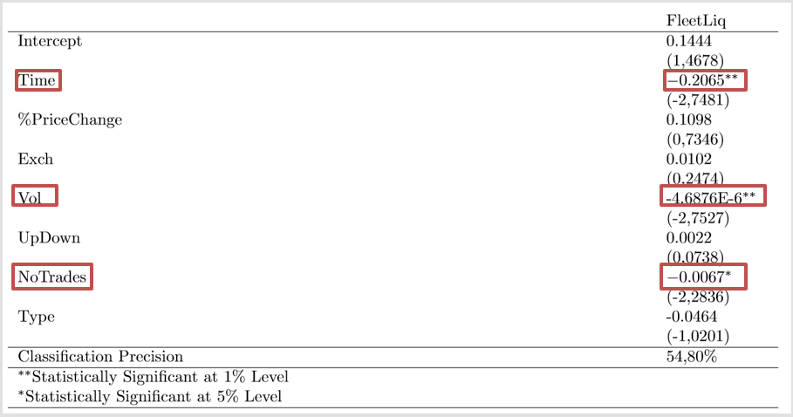
Fleeting Liquidity
Fleeting Liquidity is characteristic of ultra-fast Mini Flash Crashes of small volume and a small number of trades.
Notes:
two variables, Time and Vol, are signiﬁcant at the 1% level, and NbTrades is signiﬁcant at the 5% level
all three coeﬃcients are negative, implying that Fleeting Liquidity is characteristic of ultra-fast Mini Flash Crashes of small volume and a small number of trades.

Slide 21
Conclusion
Mini Flash Crashes are the result of regulatory framework and market fragmentation; in particular due to aggressive use of Intermarket Sweep Orders and Regulation NMS protecting only the Top of the Book.
Mini Flash Crashes have an adverse impact on market liquidity resulting in wider spread, increased number of locked and crossed NBBO quotes and decrease in quoted volume.
The phenomenon of Fleeting Liquidity associated with Mini Flash Crashes, which is ultra-fast, small volume, and a small number of trades.
The paper suggest that regulators pay particular attention to ISO-initiated Mini Flash Crashes and take appropriate actions against market participants responsible for such Mini Flash Crashes.

Slide 22
My thoughts
Likes
Dislikes
Fully Absorbed the previous research findings.
Created a method for classifying the mini flash crash.
Derived the main conclusion based on descriptive analysis
The logit regression model didn’t address the main cause of the mini flash crash
Notes:
Finding that Mini Flash Crashes are the product of market regulation.
Dislikes:
Derived the cause and impact of mini flash crash based on descriptive analysis and event study, lack of econometic analysis to be more reliable
The logit regression model didn’t address the main cause of the mini flash crash, it only focused on the relationship between the
Artificial liquidity and the characteristics of mini flash crash. So I think this paper’s empirical study process kind of deviate from the research
Target.
The paper criticized the Top of Book Protection as the main cause for such crashes, and came up with the full order-book protection proposal.
However, such a requirement for market participants to comply with the same trade-through protection for the entire Depth of the Book quotations would be extremely costly and complex.
The author also claimed that the regulators should consider the banning of ISOs, which will harm the efficiency for high frequency traders.

Slide 23

Thanks for listening!
Any Questions?

